Slide 1

Coding Lesson 3
Loops
Elementary Coaches Academy

Slide 2
Learning Objective
Learn the different types of loops
Implement loops in Python
Avoid endless loops

Slide 3
Definition: Loop
A loop is used to repeat commands in a program.
Python has just two types of loops

Slide 4

Definition: For Loop
This counting loop is used to repeat something an exact number of times.

Slide 5

Lab Lecture
This Scratch block is equivalent to this Python for loop
How many times do you think the Python for loop will repeat?

Slide 6
Definition: For Loop
The range() function is used to loop through some code a specified number of times

Slide 7

Warm up
Open the starter File
https://repl.it/Lesson3WarmpUp
Run the program by clicking the run button

Slide 8
Warm up
What kind of loop does this use?
When will the loop stop?

Slide 9
Warm up
Change the program so the arrow goes all the way across the screen.
Challenge: Make the arrow turn around and
go back to the beginning
Notes:
Challenge hint: add another loop after the first one

Slide 10

Definition: While Loop
This loop repeats until a certain condition is met.
Often used to react to user input or events.

Slide 11
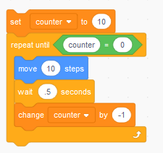

Definition: While Loop
This Scratch repeat until block is equivalent to this Python while loop

Slide 12

Definition: Infinite While Loop
This loop runs “forever”
...or until your program is stopped.

Slide 13
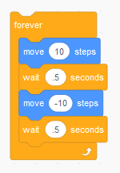
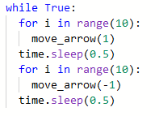
Definition: Infinite While Loop
This Scratch forever block is equivalent to this Python infinite while loop

Slide 14
Lab Lecture
Open the starter file
https://repl.it/Lesson3LabLecture

Slide 15
Lab Lecture
Make an infinite while loop that makes the arrow move back and forth ten spaces

Slide 16
Lab Lecture
Discuss: How is the forever loop different than the repeat loop?

Slide 17
Lab Lecture
Change the program so the infinite while loop is just a regular while loop.
Hint: use the counter variable!

Slide 18
Practice
https://drive.google.com/file/d/1El9Ehh9z5Oov9EmedbZ2p7ys1tpOtgiG/view?usp=sharing
Mild - perfect for beginners
Medium - expanding your skills
Spicy - looking for a challenge?
Notes:
Link to Teacher’s copy (solutions) of practice exercises

Slide 19
Journal
Discuss - how can coding be used to reinforce core subject areas?

